Slide 1
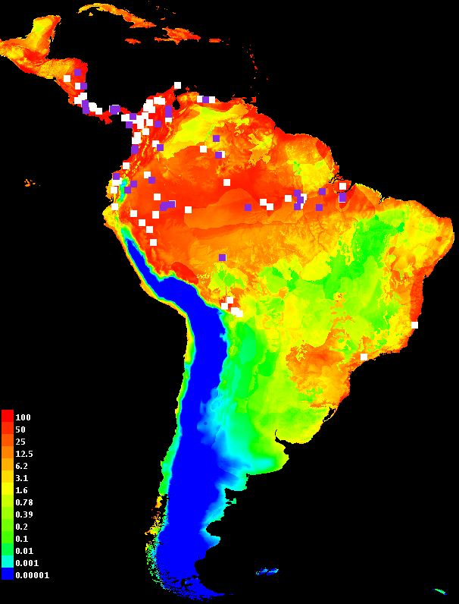
Introduction to Maxent
Bob Muscarella
Aarhus University
Uppsala SDM course
(April 22, 2015)
Thanks!
Steven Phillips
Cory Merow
Adam Smith

Slide 2
Maxent overview
How NOT to think about Maxent
Maxent
GUI
Occurrence
records

Slide 3
Occurrence
points
Probability distribution for occurrence points
Predictor
variables
Background
points

Slide 4
Process
Data input
Model
fitting
Occurrence
points
Projecting
Probability distribution for occurrence points
Predictor
variables
Background
points

Slide 5
Process
Data input
Model
fitting
Occurrence
points
Projecting
Probability distribution for occurrence points
Predictor
variables
Background
points
How to define background?
What variables matter?
Are the data biased?
What type of output?
Clamping?
What settings should I use?
How should I evaluate?
Technical considerations

Slide 6
Process
Data input
Model
fitting
Occurrence
points
Projecting
Probability distribution for occurrence points
Predictor
variables
Background
points
How to define background?
What variables matter?
Are the data biased?
What type of output?
Clamping?
What settings should I use?
How should I evaluate?
Technical considerations
What are my assumptions?
What does it really mean?
Is my model
biologically sensible?
Conceptual issues

Slide 7
Maximum Entropy
Maximum entropy methods are general ways to predict probability distributions (e.g. species occurrence) given constraints on their moments (e.g., mean / variance of average temperature).
Species distributions along environmental gradients
Species relative abundance curves
Trait-based community composition
Many other applications in and outside of ecology…

Slide 8
Maximum Entropy
Maximum entropy methods are general ways to predict probability distributions (e.g. species occurrence) given constraints on their moments (e.g., mean / variance of average temperature).
Entropy is the amount of information contained in each piece of data. We are trying to find the probability distribution with the maximum entropy given our observations (data) on the system.

Slide 9
What is entropy maximization? (in words)
Two parts:
Constraints
The data define moment constraints on the probability distribution
e.g., The temperature at presence locations defines the mean of temperature where the species occurs
The predicted distribution needs to fulfill the constraints
Entropy
Many distributions could fulfill the constraints
Maximizing entropy is a method to choose among the probability distributions that fit your data
Start by assuming the probability is uniform in geographic space and moves away from this distribution to fit the constraints

Slide 10
What is entropy maximization? (in words)
Two parts:
Constraints
The data define moment constraints on the probability distribution
e.g., The temperature at presence locations defines the mean of temperature where the species occurs
The predicted distribution needs to fulfill the constraints
Entropy
Many distributions could fulfill the constraints
Maximizing entropy is a method to choose among the probability distributions that fit your data
Start by assuming the probability is uniform in geographic space and moves away from this distribution to fit the constraints

Slide 11

What is entropy maximization? (in pictures)
°C=30 | °C=20 | °C=10
°C=30 | °C=20 | °C=10
°C=30 | °C=20 | °C=10
Pelle Svanslös
(Felis catus)
Temperature Gradient

Slide 12

Observations:
°C=30 | °C=20 | °C=10
°C=30 | °C=20 | °C=10
°C=30 | °C=20 | °C=10
Temperature

Slide 13
Observations + constraints:
Constraint 1:
Mean °C:
Constraint 2:
Uniform prior expectation across extent:
p_{i} = relative probability
of observing the species
in cell i.
°C=30 p=1/9 | °C=20 p=1/9 | °C=10 p=1/9
°C=30 p=1/9 | °C=20 p=1/9 | °C=10 p=1/9
°C=30 p=1/9 | °C=20 p=1/9 | °C=10 p=1/9
Temperature

Slide 14
This prediction matches constraint 2 but not constraint 1.
Constraint 1:
Mean °C:
Constraint 2:
Uniform prior expectation across extent:
p_{i} = relative probability
of observing the species
in cell i.
°C=30 p=0 | °C=20 p=1/3 | °C=10 p=0
°C=30 p=0 | °C=20 p=1/3 | °C=10 p=0
°C=30 p=0 | °C=20 p=1/3 | °C=10 p=0
✓
✗
Temperature

Slide 15
Maximum entropy prediction; both constraints fulfilled.
Constraint 1:
Mean °C:
Constraint 2:
Uniform prior expectation across extent:
p_{i} = relative probability
of observing the species
in cell i.
°C=30 p=1/9 | °C=20 p=1/9 | °C=10 p=1/9
°C=30 p=1/9 | °C=20 p=1/9 | °C=10 p=1/9
°C=30 p=1/9 | °C=20 p=1/9 | °C=10 p=1/9
✓
✓
Temperature

Slide 16
Maximum entropy prediction; both constraints fulfilled.
Constraint 1:
Mean °C:
Constraint 2:
Uniform prior expectation across extent:
p_{i} = relative probability
of observing the species
in cell i.
°C=30 p=1/9 | °C=20 p=1/9 | °C=10 p=1/9
°C=30 p=1/9 | °C=20 p=1/9 | °C=10 p=1/9
°C=30 p=1/9 | °C=20 p=1/9 | °C=10 p=1/9
✓
✓
Temperature
Uniform by default,
but not necessarily
(e.g., dispersal limitation, etc.)

Slide 17
Maxent – practical matters
Occurrence
points
Data input
Probability distribution for occurrence points
Predictor
variables
Background
points

Slide 18
Data input
Species occurrence (presence) locations
Background locations
Not necessarily user-defined…
Environmental covariates
(continuous/categorical)
Optional:
Grid of sample effort
Landscape for projecting model
Species | Lat | Lon
spX | 18.1 | 66.3
spX | 18.2 | 66.5
… | … | …
Species | Lat | Lon
BG | 18.0 | 67.1
BG | 18.6 | 65.4
… | … | …
Point | Env1 | Env2 | Env3
spX1 | 12 | 0.3 | A
BG1 | 18 | 0.4 | B
… | … | … | …

Slide 19
Maxent – practical matters
Model
fitting
Occurrence
points
Probability distribution for occurrence points
Predictor
variables
Background
points

Slide 20
Model fitting
Maximize the gain function

Slide 21
Model fitting
Maximize the gain function
Maximize this!!
Sum of predicted values at presence locations
Sum of predicted values at background locations
Penalty for
overfitting

Slide 22
Model fitting
Maximize the gain function
Maximize this!!
Sum of predicted values at presence locations
Sum of predicted values at background locations
Penalty for
overfitting
Based on input data;
subject to constraints
Based on settings chosen;
helps avoid overfitting

Slide 23
Model fitting
Maximize the gain function
Start with uniform distribution and search parameter space until the increase in gain is below a specified level of convergence.
Maximizing the gain = finding a model that can best differentiate between conditions at presence and background locations.
At the end of the run, the gain says how closely the model is concentrated around the presence samples.
Note that Maxent doesn’t directly calculate “probability of occurrence”.
Sum of predicted values at presence locations
Sum of predicted values at background locations
Penalty for
overfitting

Slide 24
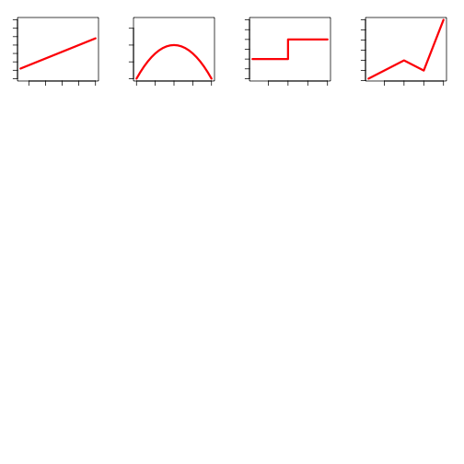
Settings: feature classes (constraints)
Feature classes
Types of features
(L) Linear: constrains prediction to fit the observed mean
(Q) Quadratic: constrains prediction to fit the observed variance
(P) Product: constrains covariance between predictors
(T) Threshold: convert continuous variables to binary
(H) Hinge: similar to threshold but with linear function
Linear
Quadratic
Threshold
Hinge
Probability
Value of a single predictor variable

Slide 25
Settings: feature classes (constraints)
Feature classes
Types of features
(L) Linear: constrains prediction to fit the observed mean
(Q) Quadratic: constrains prediction to fit the observed variance
(P) Product: constrains covariance between predictors
(T) Threshold: convert continuous variables to binary
(H) Hinge: similar to threshold but with linear function
Linear
Quadratic
Threshold
Hinge
Probability
Value of a single predictor variable
* By default, Maxent chooses which feature classes to allow based on the number of occurrence records

Slide 26
Settings: feature classes (constraints)
Feature classes
Types of features
(L) Linear: constrains prediction to fit the observed mean
(Q) Quadratic: constrains prediction to fit the observed variance
(P) Product: constrains covariance between predictors
(T) Threshold: convert continuous variables to binary
(H) Hinge: similar to threshold but with linear function
Linear
Quadratic
Threshold
Hinge
Probability
Value of a single predictor variable
** Allowing different feature classes does not necessarily mean they are used (depends on gain)

Slide 27
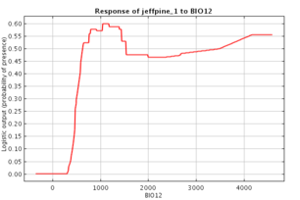
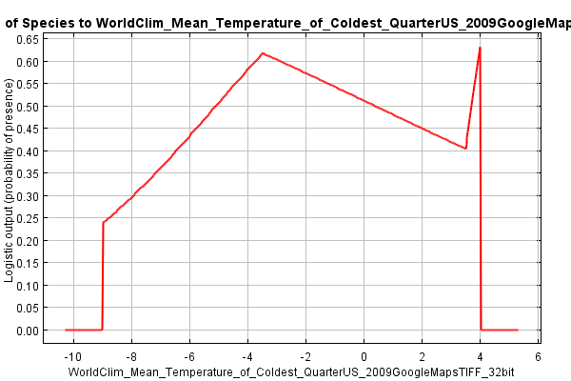
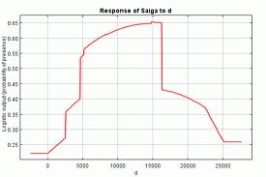
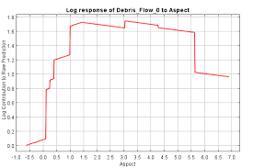
Model fitting
Response curves (examples)
Probability
Predictor variable

Slide 28
Model fitting
Response curves (examples)
Consider
model complexity
What is biologically sensible?
Probability
Predictor variable

Slide 29
Settings: Regularization
We don’t necessarily want to fit the constraints exactly, they just need to be close
- Is the optimal temperature for your species 17.45°? Or is 17-18° better?
Regularization alters the gain function to avoid overfitting the data
Also acts as a penalty for including parameters
Consider
model complexity
What is biologically sensible?
Probability
Predictor variable

Slide 30
Settings: Regularization
We don’t necessarily want to fit the constraints exactly, they just need to be close
- Is the optimal temperature for your species 17.45°? Or is 17-18° better?
Regularization alters the gain function to avoid overfitting the data
Also acts as a penalty for including parameters
Consider
model complexity
What is biologically sensible?
Probability
Predictor variable

Slide 31
Settings: Take home messages
Feature classes
Should be biologically sensible
Allowing more types increases complexity
Regularization
Higher values relax constraints (smoothes response curves)
Higher values = higher penalty for complexity
Choosing settings:
Think! What makes sense for the biology of your organism?
The question) you are addressing?
Refer to Merow et al. 2013
Use ‘ENMeval’ R-package to choose based on evaluation statistics (more on this tomorrow!)

Slide 32
Settings: Take home messages
Feature classes
Should be biologically sensible
Allowing more types increases complexity
Regularization
Higher values relax constraints (smoothes response curves)
Higher values = higher penalty for complexity
Choosing settings:
Think! What makes sense for the biology of your organism?
The questions you are addressing?
Refer to Merow et al. 2013
Use ‘ENMeval’ R-package to choose based on evaluation statistics (more on this tomorrow!)

Slide 33
Settings: Take home messages
Feature classes
Should be biologically sensible
Allowing more types increases complexity
Regularization
Higher values relax constraints (smoothes response curves)
Higher values = higher penalty for complexity
Choosing settings:
Think! What makes sense for the biology of your organism?
The questions you are addressing?
Refer to Merow et al. 2013
Use ‘ENMeval’ R-package to choose based on evaluation statistics

Slide 34
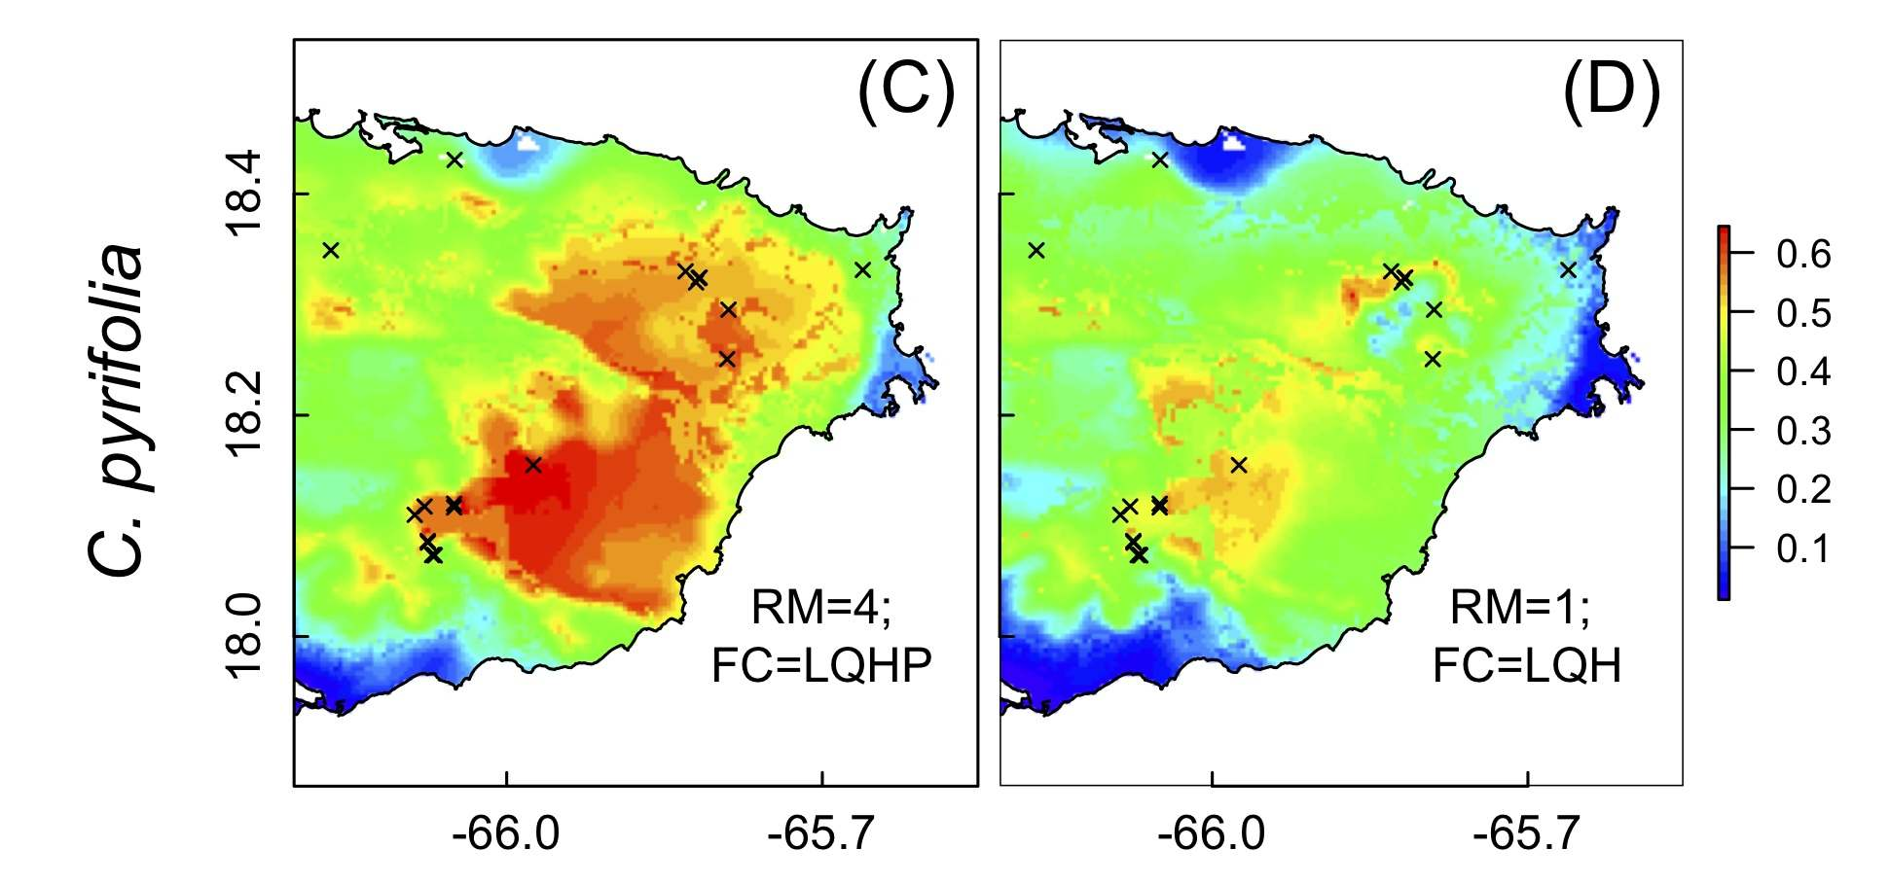
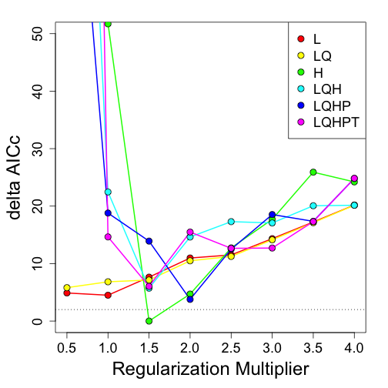
Settings: Take home messages
AICc
Default
Default
ΔAICc
AICc
In this case, default settings gave a model that was relatively overfit to presence points.

Slide 35
Output
A probability distribution that sums to 1 (across training points)
The relative probability of observing the species in each cell
Transformed output values:
logistic (0-1, visualization),
cumulative (probability density)
Model
fitting
Projecting
Probability distribution for occurrence points

Slide 36
Output
A probability distribution that sums to 1 (across training points)
The relative probability of observing the species in each cell
Transformed output values:
logistic (0-1, visualization),
cumulative (probability density)
Other diagnostics and evaluation statistics
Model
fitting
Projecting
Probability distribution for occurrence points

Slide 37
Output
A probability distribution that sums to 1 (across training points)
The relative probability of observing the species in each cell
Transformed output values:
logistic (0-1, visualization),
cumulative (probability density)
Other diagnostics and evaluation statistics
Relative variable contribution to model
Model
fitting
Projecting
Probability distribution for occurrence points

Slide 38
Why use Maxent?
Presence only data
Explore complex relationships with environment (But don’t retain ALL the complex relationships)
Good for small data sets
Many species to process
Predictions compare favorably to presence/psuedo-absence models when tested against real pres/abs data (e.g., Elith et al 2006)

Slide 39
Why use Maxent?
Presence only data
Explore complex relationships with environment (But don’t retain ALL the complex relationships)
Good for small data sets
Many species to process
Predictions compare favorably to presence/psuedo-absence models when tested against real pres/abs data (e.g., Elith et al 2006)
If you have Presence/Absence data, where you believe the absences at the spatial scale that you’re modeling
Statistical properties not well understood – prediction variance limited to resampling methods
Software is a bit of a black box (use R!)
Why NOT use Maxent?

Slide 40
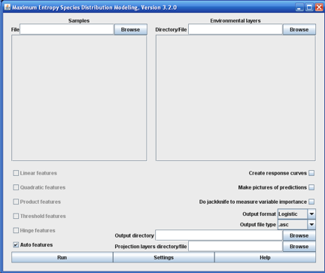
Maxent GUI Maxent in R
via ‘dismo’ package…

Slide 41
Running Maxent in R
> library(dismo)
> maxent (x, p, ...)
x = predictors (typically a RasterStack)*
p = presence points (typically matrix of lat/lon)*
… = Additional arguments (all options of GUI are available in R)
* Other formats are possible

Slide 42
Running Maxent in R
> library(dismo)
> maxent (x, p, ...)
x = predictors (typically a RasterStack)*
p = presence points (typically matrix of lat/lon)*
… = Additional arguments (all options of GUI are available in R)
* See Resources Folder
Flag | Abbrv | Type | Default | Meaning
addallsamplestobackground |  | boolean | FALSE | Add all samples to the background, even if they have combinations of environmental values that are already present in the background
addsamplestobackground | d | boolean | TRUE | Add to the background any sample for which has a combination of environmental values that isn't already present in the background
adjustsampleradius |  | integer | 0 | Add this number of pixels to the radius of white/purple dots for samples on pictures of predictions. Negative values reduce size of dots.
… | … | … | … | …

Slide 43
Questions?
Exercise using GUI
Follow step-by-step “Maxent GUI demo.pdf”
Exercise using R
Follow R script “Maxent_exercises.R”

